Slide 1
High-Throughput Screening Assay and Animal-Based Assay Correlations
Patra Volarath
Cheminformatics Scientist
Office of Food Additive Safety (OFAS)
Center for Food Safety and Applied Nutrition (CFSAN)
U.S. Food and Drug Administration

Slide 2
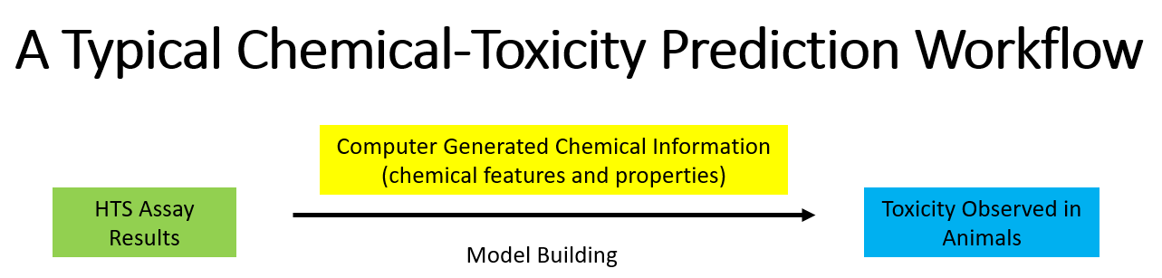
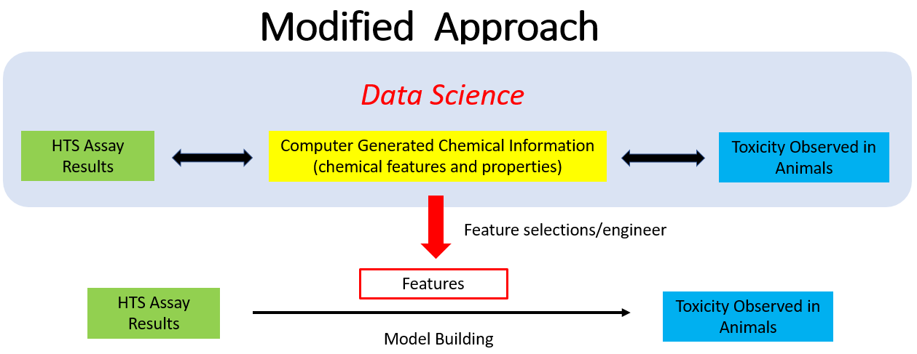

Slide 3
 | Original Datasets
 | US EPA’s ToxCast Data (released 2015) |  |  | Computer Generated Data
 | HTS Assay Results | Chemical Information | Animal Test Outcomes | Chemical Features
Rows | 9976 chemicals | 9011 chemicals | 883 chemicals | 9011 chemicals
Columns | 1192 results | 4 identifiers | 1045 outcomes | 729 features
Values | Binary | - | Concentrations ( continuous) | Binary
 | Datasets (after cleanup)
 | US EPA’s ToxCast Data (released 2015) |  |  | Computer Generated Data
 | HTS Assay Results | Chemical Information | Animal Test Outcomes | Chemical Features
Rows | 6576 chemicals | 9011 chemicals | 883 chemicals | 9011 chemicals
Columns | 985 results | 4 identifiers | 152 outcomes* | 729 features
Values | Binary | - | Binary | Binary
*$Chronic Rat Carcinogenicity endpoints = target variable (approach = supervised approach)
Data Cleaning:
ID Mapping across the datasets, converting continuous values to binary values (NA, 0 = inactivity, 1 = activity), selecting common chemicals across the datasets
No new variable is created

Slide 4
Data Distribution: Chronic Rat Carcinogenicity endpoints
Total chemicals = 883
Imbalanced Dataset!!!!
Number of Chemicals
Category A = chemicals whose activities are undetermined (NA) in all assays
Category B = chemicals that are active in at least one assay
Category C = chemicals that are inactive in all assays

Slide 5
Combining Mouse + Rat Carcinogenicity Endpoints
Data types: NA (not applicable), Active (1), Inactive (0)
Rules:
Mouse | Rat | Final Call
1 | 1 | 1
0 | 0 | 0
1 | 0 | 1
0 | 1 | 1
NA | 1 | 1
1 | NA | 1
NA | 0 | 0
0 | NA | 0
NA | NA | NA

Slide 6
Data Distribution: Chronic Rat + Mouse Carcinogenicity Endpoints
Total chemicals = 883
523
Still Imbalance Dataset!!
346
Number of Chemicals
15

Slide 7
New Questions
How did your EDA & problem inform your modeling approach? What new insights did you discover? What further modeling approaches do you wish to try? What new questions did this process uncover?
New insights/questions: New approaches in slicing and dicing the data are needed
Model approach: Classification methods
How can the directors/TAs be of assistance between now and Oct 11th?
Evaluate/provide feedback on my approaches
What is your plan to get from now to Oct 11th?
How do you hope your findings will inform your work?
Gain a better understanding of these types of datasets and workflow development
What feedback have you received from your manager?
He agrees with my approach so far

